Slide 1


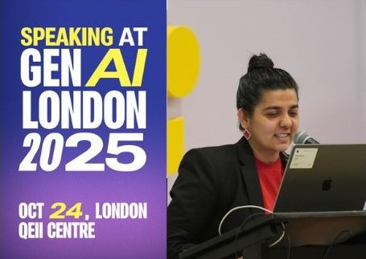
Building Reliable AI Systems:
From Hype to Practical Toolkits
“Let’s make AI systems not just smart, but dependable.”
Kannupriya Kalra – Engineering Leader @ LLM4S

Slide 2
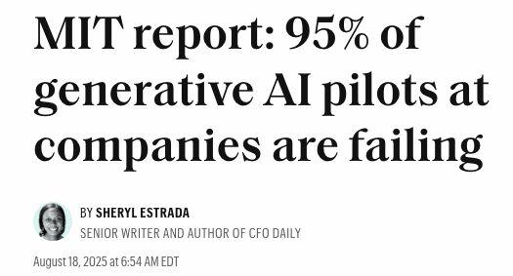
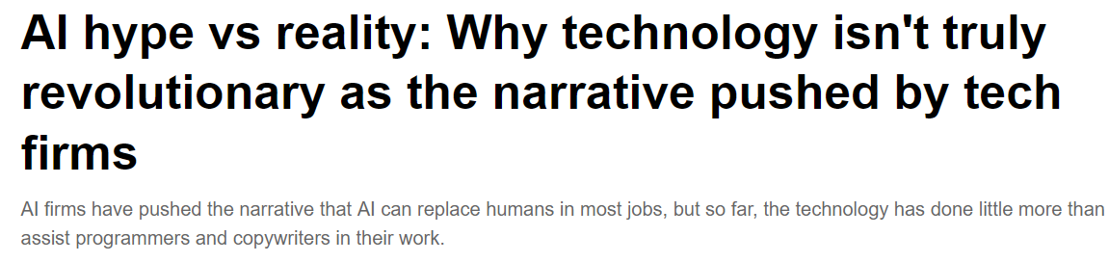
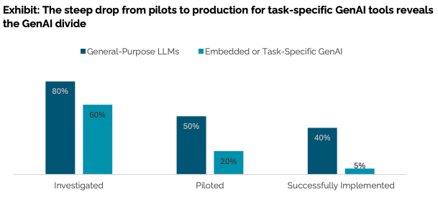

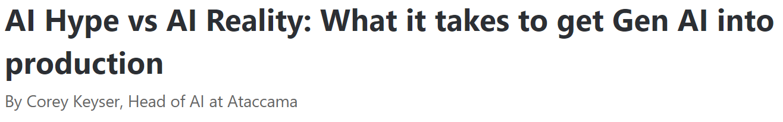

AI Hype vs Reality

Slide 3
AI Hype vs Reality
Demos amaze, but systems collapse under real load.
Most GenAI pilots fail before production.
Key reasons:
Hallucination & lack of grounding
Scaling & latency scaling issues
Management:
Observability
Measurability
Lack of feedback cycles
From "cool prototypes" → to "critical systems"

Slide 4
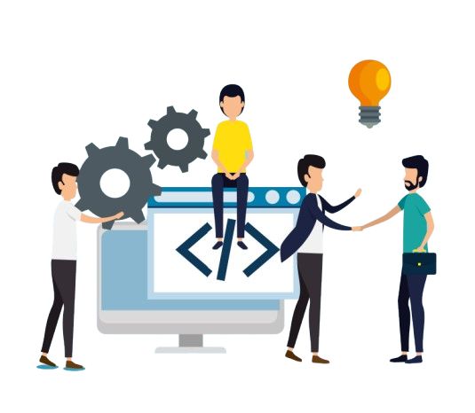
From Models to Systems
LLM ≠ Product
A large language model alone is not a reliable production system.system
A Reliable AI System = LLM + Context + Data + Tools + Observability + Governance + Feedback Cycles
Each piece adds stability, context grounds responses, data ensures truth, tools enable action, observability tracks behavior, governance builds trust, feedback cycles allow us to optimise
LLM4S brings structure and safety to all these moving parts making AI predictable, scalable, and production-ready.

Slide 5

The Reliability Imperative
Why Reliability?
Trust & Reproducibility Teams adopt AI only when outputs are consistent and explainable.
Governance & Compliance Organizations need transparency and audit trails to meet safety and regulatory standards.
Cost & Performance Control Reliable systems optimize inference cost, latency, and scalability.
Reliability isn’t post-facto testing it’s design. It’s about building AI like software structured, measurable, and predictable.

Slide 6
Introducing LLM4S
LLM4S – Large Language Models for Scala
A type-safe, structured, and composable toolkit for building reliable What it enables: ⚙️ Multi-provider integration OpenAI, Anthropic, Gemini, Ollama, and more. 🔍 Observability & tracing Understand, debug, and measure every call. 🧠 Agentic workflows Multi-step reasoning and tool calling built in. 🎨 Multi-modal generation Text, image, and speech through one unified API.
LLM4S turns LLM experiments into production-grade AI systems.

Slide 7

LLM4S Design Philosophy
Pillars of Reliability in LLM4S 1️⃣ Composable Modules: RAG, agents, tracing, tools. 2️⃣ Type Safety: catch prompt and context errors at compile time. 3️⃣ Tracing & Observability: understand, debug, and optimize. 4️⃣ Multi-provider Support: OpenAI, Anthropic, Gemini, Ollama. 5️⃣ Scalability: plug-and-play architectures with consistent APIs.

Slide 8
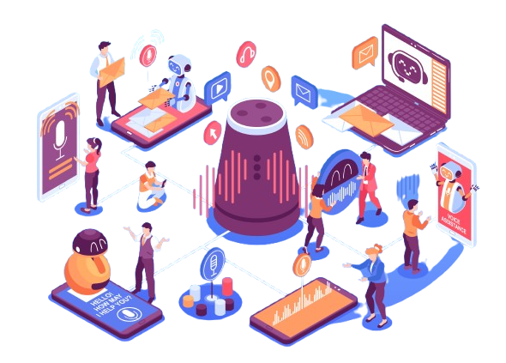
Retrieval-Augmented Generation (RAG)
Grounded by Design: Retrieval → Generate → Cite
Connects to multiple data sources: PDFs, CSVs, web pages, and databases.
Uses FAISS and PGVector for fast, scalable retrieval.
Ensures factual and context-aware responses — no retrieval means no answer.
Built-in evaluation for accuracy, latency, cost, and safety.
Produces outputs that are traceable, measurable, and reliable.

Slide 9

Model Context Protocol (MCP)
One unified protocol for context and tool interaction
Extends LLM4S agents to connect with any external tool or service.
Integrates APIs, databases, and cloud systems through a standard interface.
Enables scaling — tools can be added, swapped, or upgraded without code changes.
Maintains consistent, modular, and easily manageable AI workflows.

Slide 10
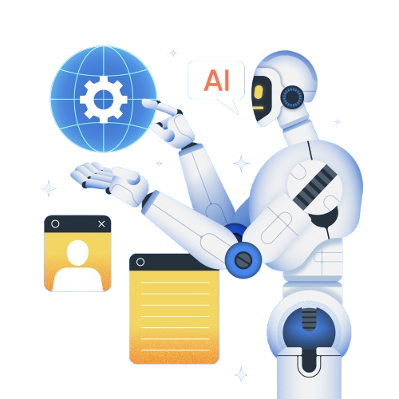
Agentic Workflows
From single prompts to autonomous reasoning
LLM4S agents can plan, act, and verify through structured multi-step workflows.
Support execution of commands, API calls, and tool interactions in safe environments.
Move beyond chat responses to enable reliable automation and reasoning.
Power diverse use cases — from code generation to enterprise workflows and interactive experiences like Szork.

Slide 11

Tracing & Observability
Turning AI’s black box into a transparent system
LLM4S tracing captures every step — from user input to model response and tool execution.
Supports OpenTelemetry integrations with tools like Langfuse and MLflow.
Provides detailed analytics on timelines, token usage, latency, and cost.
Console tracing enables quick visibility during local development.
Converts experimentation into measurable performance for debugging and optimization.

Slide 12

Multimodal Capabilities
Unified API for:
Image Generation: Powered by Stable Diffusion for creating dynamic visuals.
Speech-to-Text: Integrates Whisper and CMU Sphinx for accurate voice input.
Text-to-Speech: Uses Tacotron2 for natural and expressive audio output.
Tool Calling for Interactivity: Enables real-time actions in scenarios like inventory, games, and simulations.

Slide 13

Reliability in Production
Production = Predictability
Safe workspaces (sandboxed agents)
Retry & error handling built-in
Config-driven model switching
Structured logs & metrics
Works with Scala’s concurrency & parallelism

Slide 14
What You Can Build Today
Use Case | Description | Status
Conversational Agents | Type-safe, multi-turn chatbots | ✅ Shown
RAG Systems | Enterprise knowledge Q&A | 🚧 Coming soon
Code Generation | AI-assisted Scala coding | ✅ Shown
Image Processing | Multimodal integration | ✅ Shown
Workflow Automation | Multi-step agents | ✅ Shown
Semantic Search | Vector retrieval | 🚧 In progress

Slide 15

The Road Ahead & Community
Coming Next:
Streaming responses
Enhanced MCP introspection
More model providers
Better production templates 🌍 Community: 100+ global contributors “Learn AI by Building AI” 🔗 GitHub | Discord | Docs

Slide 16

Key Takeaways & Q&A
✅ Reliable AI = Design + Discipline ✅ Frameworks > Ad-hoc scripts ✅ LLM4S brings structure, reliability & scale 💬 “Build the cool stuff — and make it work in production.”
📬 Contact: kannupriyakalra@gmail.com 🔗 linkedin.com/in/kannupriyakalra | github.com/llm4s
Notes:
So, to wrap up — reliability isn’t something you hope for; it’s something you design.
Frameworks like LLM4S bring the discipline of software engineering into AI.
They make systems measurable, observable, and scalable.
The future of AI isn’t about bigger models — it’s about better systems.
Thank you so much for listening — I’d love to take your questions, or just chat after the session about how you’re building reliable AI where you work.

Slide 17

Don’t forget to star us on Github :)

